Slide 1


Slide 2

The Indian Premier League (IPL), which features elite cricket players and draws sizable crowds, has become one of the world's most watched cricket competitions. In order to gain insight into player performance, team dynamics, and match outcomes, this project will use MySQL for analyzing data from the last three(2021-2022-2023) IPL seasons.

Slide 3

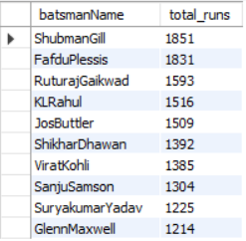
What is the total number of runs scored by each top 10 player in the IPL
SELECT batting_summary.batsmanName, SUM(batting_summary.runs) AS total_runsFROM batting_summaryGROUP BY batting_summary.batsmanNameORDER BY total_runs DESC
LIMIT 10;

Slide 4

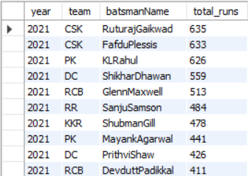
Total run scored by batsman team in each seasons
SELECT match_summery.year, players.team, batting_summary.batsmanName, SUM(batting_summary.runs) AS total_runsFROM match_summery JOIN batting_summary ON match_summery.match_id = batting_summary.match_id JOIN players ON batting_summary.batsmanName = players.nameWHERE year IN (2021 , 2022, 2023)GROUP BY match_summery.year , players.team , batting_summary.batsmanNameORDER BY match_summery.year ASC , SUM(batting_summary.runs) DESCLIMIT 50;

Slide 5
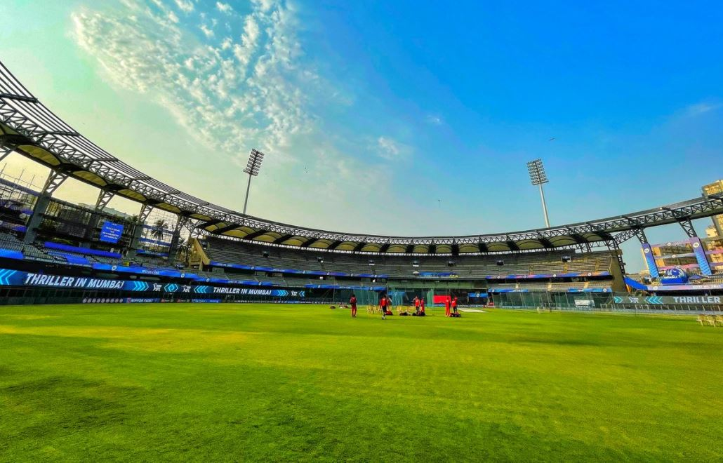
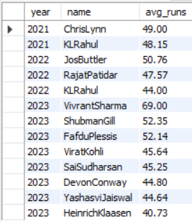
Average run scored by each players in 2021 2022 2023
SELECT match_summery.year, players.name, ROUND(AVG(batting_summary.runs), 2) AS avg_runsFROM players JOIN batting_summary ON batting_summary.batsmanName = players.name JOIN match_summery ON batting_summary.match_id = match_summery.match_idWHERE year IN (2021 , 2022, 2023)GROUP BY match_summery.year , players.nameHAVING AVG(batting_summary.runs) > 40ORDER BY match_summery.year ASC , AVG(batting_summary.runs) DESC;

Slide 6
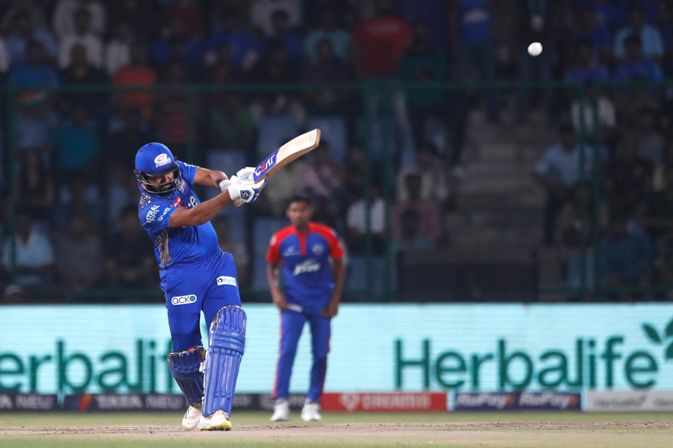
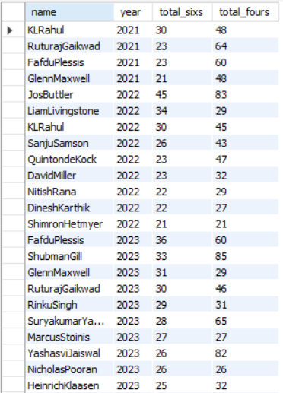
Players name with total sixes and total fours in year 2021,2022,2023
SELECT players.name, match_summery.year, SUM(6s) AS total_sixs, SUM(4s) AS total_foursFROM batting_summary JOIN players ON batting_summary.batsmanName = players.name JOIN match_summery ON batting_summary.match_id = match_summery.match_idWHERE year IN (2021 , 2022, 2023)GROUP BY players.name , match_summery.yearHAVING SUM(6s) > 20 AND SUM(4s) > 20ORDER BY match_summery.year ASC , SUM(6s) DESC , SUM(4s) DESC;

Slide 7


Average run score by M S Dhoni in three season's
SELECT match_summery.year, batting_summary.batsmanName, AVG(batting_summary.runs) AS avg_runsFROM batting_summary JOIN match_summery ON batting_summary.match_id = match_summery.match_idWHERE batsmanName = 'Msdhoni' AND year IN (2021 , 2022, 2023)GROUP BY match_summery.year , batting_summary.batsmanNameORDER BY match_summery.year ASC , AVG(batting_summary.runs) DESC;

Slide 8
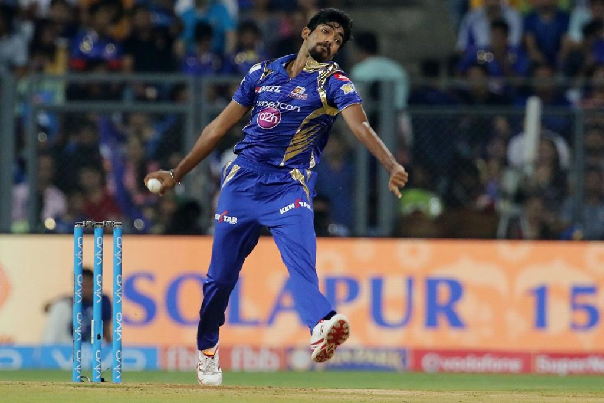
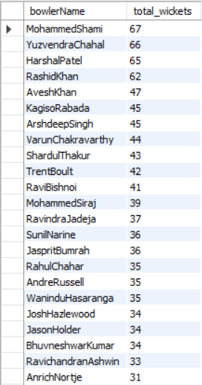
What is the total number of wickets taken by each player
SELECT bowling_summary.bowlerName, SUM(bowling_summary.wickets) AS total_wicketsFROM bowling_summaryGROUP BY bowling_summary.bowlerNameORDER BY total_wickets DESC;

Slide 9
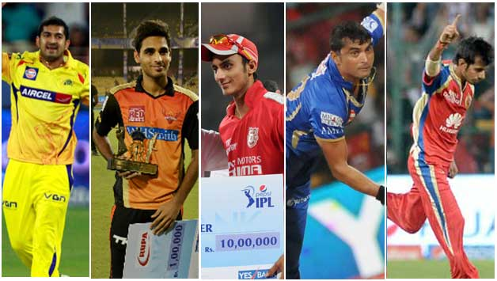
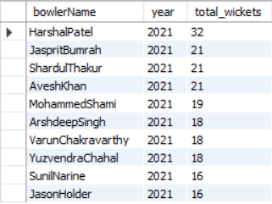
bower name with taken total wickets Who are the top 5 wicket-takers in the 2021 season
SELECT bowling_summary.bowlerName, match_summery.year, SUM(bowling_summary.wickets) AS total_wicketsFROM bowling_summary JOIN match_summery ON bowling_summary.match_id = match_summery.match_idWHERE year IN (2021 , 2022, 2023)GROUP BY bowling_summary.bowlerName , match_summery.yearORDER BY match_summery.year ASC , SUM(bowling_summary.wickets) DESCLIMIT 10;

Slide 10

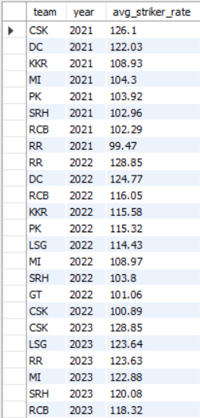
Average strike rate of all teams
SELECT players.team, match_summery.year, ROUND(AVG(batting_summary.SR), 2) AS avg_striker_rateFROM players JOIN batting_summary ON players.name = batting_summary.batsmanName JOIN match_summery ON batting_summary.match_id = match_summery.match_idWHERE year IN (2021 , 2022, 2023)GROUP BY players.team , match_summery.yearORDER BY match_summery.year ASC , AVG(batting_summary.SR) DESC;

Slide 11
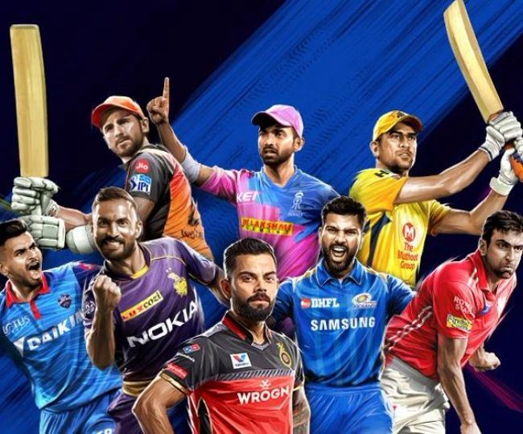
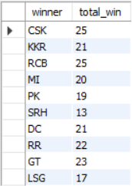
How many matches won by each team
SELECT match_summery.winner, COUNT(*) AS total_winFROM match_summeryGROUP BY match_summery.winner;

Slide 12
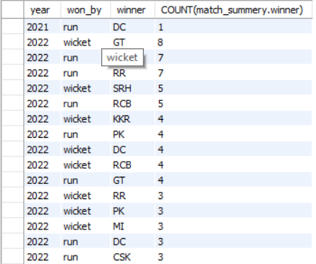
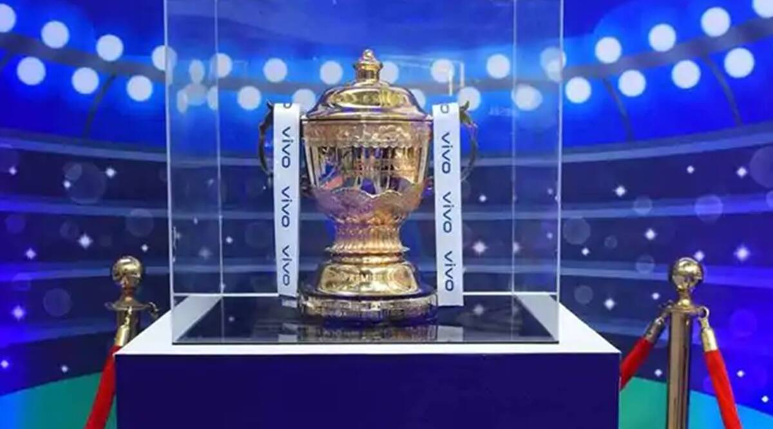
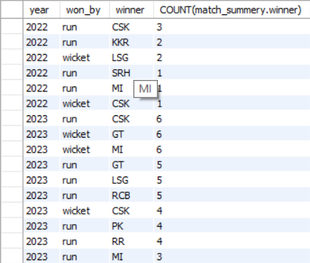
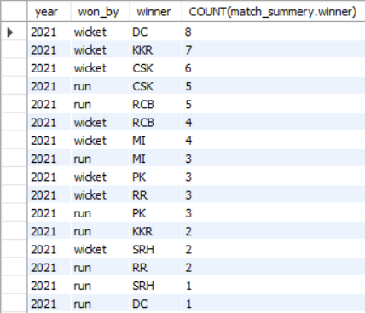
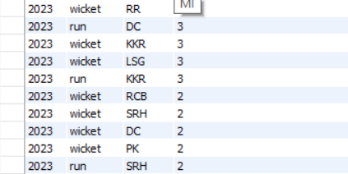
how many matches win by each team and run or wicket in three seasons
SELECT match_summery.year, match_summery.won_by, match_summery.winner, COUNT(match_summery.winner)FROM match_summeryWHERE year IN (2021 , 2022, 2023)GROUP BY match_summery.year , match_summery.won_by , match_summery.winnerORDER BY match_summery.year ASC , COUNT(match_summery.winner) DESC;

Slide 13


